Slide 1
Chapter Outline
Heterodyne
Receivers
Direct-Conversion
Receivers
Problem of Image
Mixing Spurs
Sliding-IF RX
LO Leakage and Offsets
Even-Order Nonlinearity
I/Q Mismatch
Image-Reject and
Low-IF Receivers
Transmitter
Architecture
Hartley and Weaver Receivers
Low-IF Receivers
Polyphase Filters
TX Baseband Processing
Direct-Conversion TX
Heterodyne and Sliding-IF TX

Slide 2
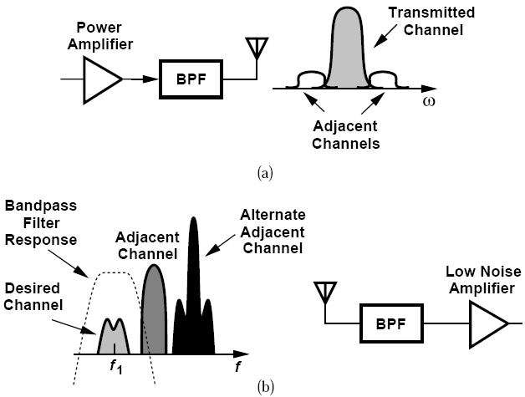
General Considerations: Narrow Channel Bandwidth
Narrow channel bandwidth impacts the RF design of the transceiver.

Slide 3
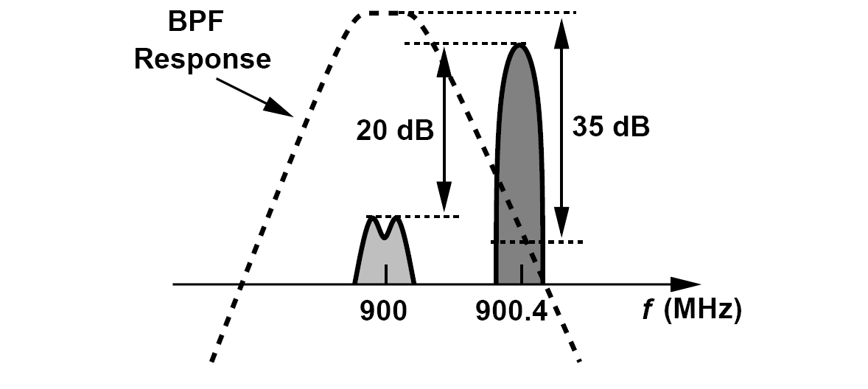
Can We Simply Filter the Interferers to Relax the Receiver Linearity Requirement?
First, the filter must provide a very high Q
Second, the filter would need a variable, yet precise center frequency

Slide 4
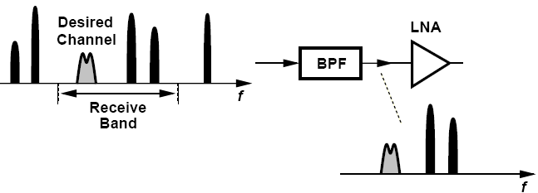
Channel Selection and Band Selection
All of the stages in the receiver chain that precede channel-selection filtering must be sufficiently linear
Channel selection must be deferred to some other point where center frequency is lower and hence required Q is more reasonable
Most receiver front ends do incorporate a “band-select” filter

Slide 5
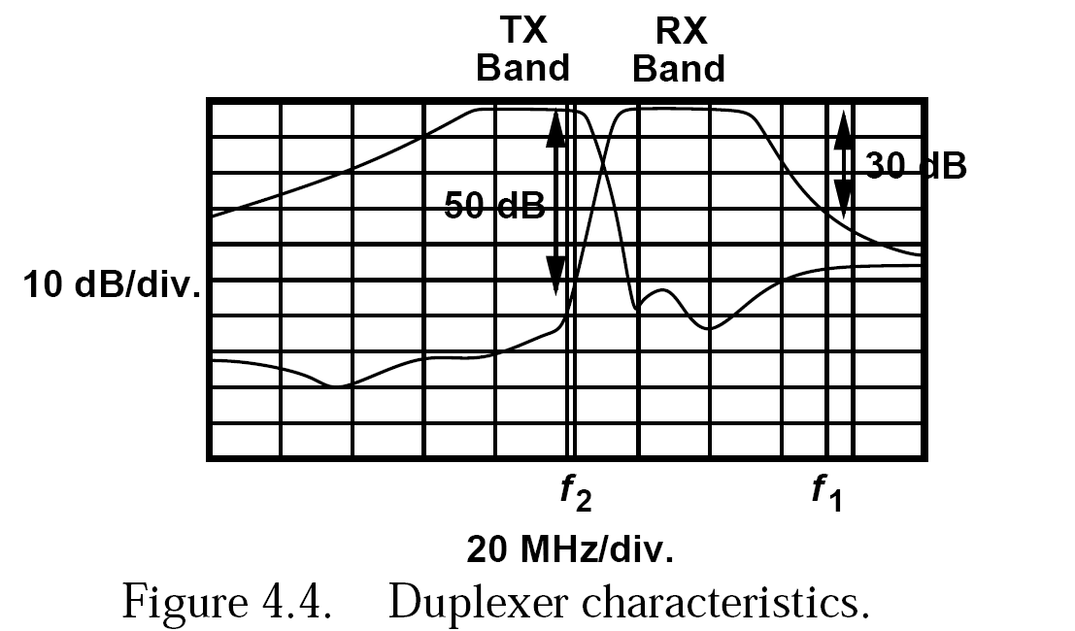
Duplexer Characteristics
The front-end band-select filter suffers from a trade-off between its selectivity and its in-band loss because the edges of the band-pass frequency response can be sharpened only by increasing the order of the filter.
Front-end loss directly raises the NF of the entire receiver

Slide 6
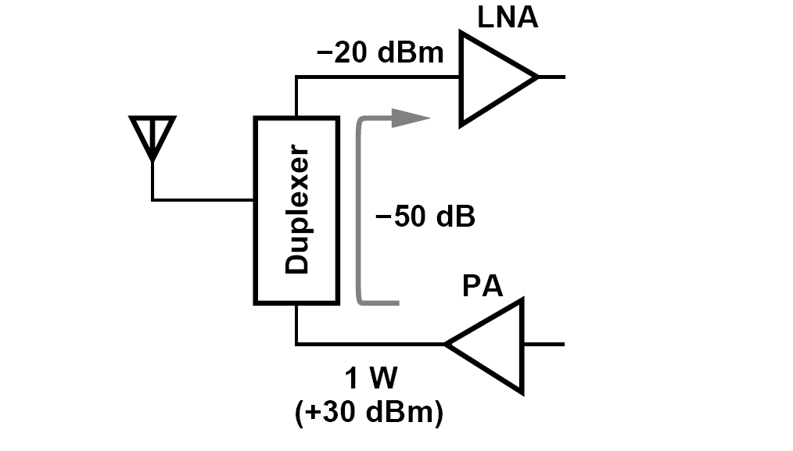
TX-RX Feedthrough
In full-duplex standards, the TX and the RX operate concurrently.
With a 1-W TX power, the leakage sensed by LNA can reach -20dBm, dictating a substantially higher RX compression point.

Slide 7
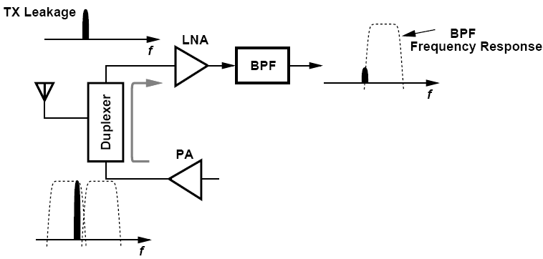
An Example of TX-RX Leakage
Explain how a band-pass filter following the LNA can alleviate the TX-RX leakage in a CDMA system.
Solution:
As depicted in below, if the BPF provides additional rejection in the TX band, the linearity required of the rest of the RX chain is proportionally relaxed. The LNA compression point, however, must still be sufficiently high.

Slide 8
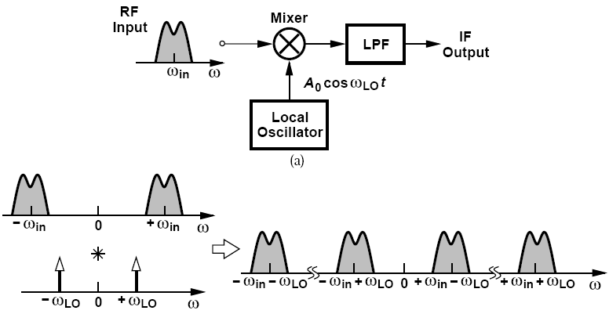
Basic Heterodyne Receivers
“Heterodyne” receivers employ an LO frequency unequal to ω_{in} and hence a nonzero IF
A Mixer performing downconversion.
Due to its high noise, the downconversion mixer is preceded by a low-noise amplifier

Slide 9
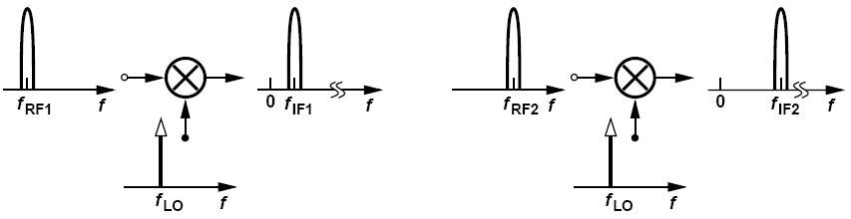
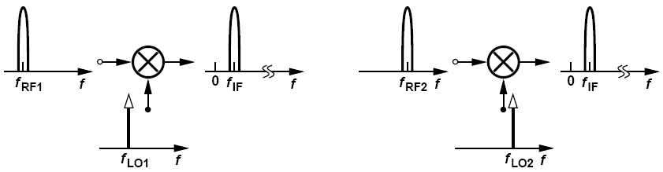
How Does a Heterodyne Receiver Cover a Given Frequency Band?
Constant LO: each RF channel is downconverted to a different IF channel
Constant IF: LO frequency is variable, all RF channels within the band of interest translated to a single value of IF.

Slide 10
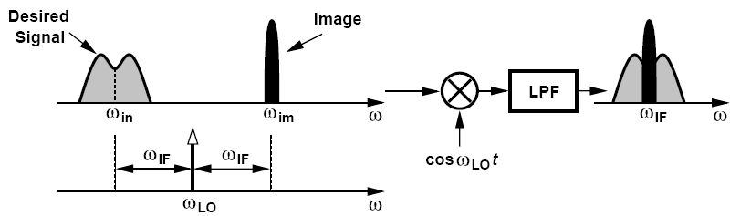
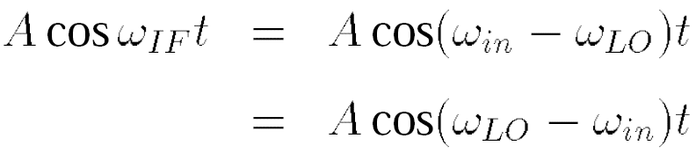
Basic Heterodyne Receivers: Problem of Image
Two spectra located symmetrically around ω_{LO} are downconverted to the IF
Notes:
Low-side injection and high side injection

Slide 11
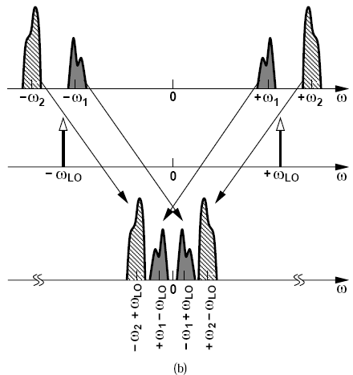
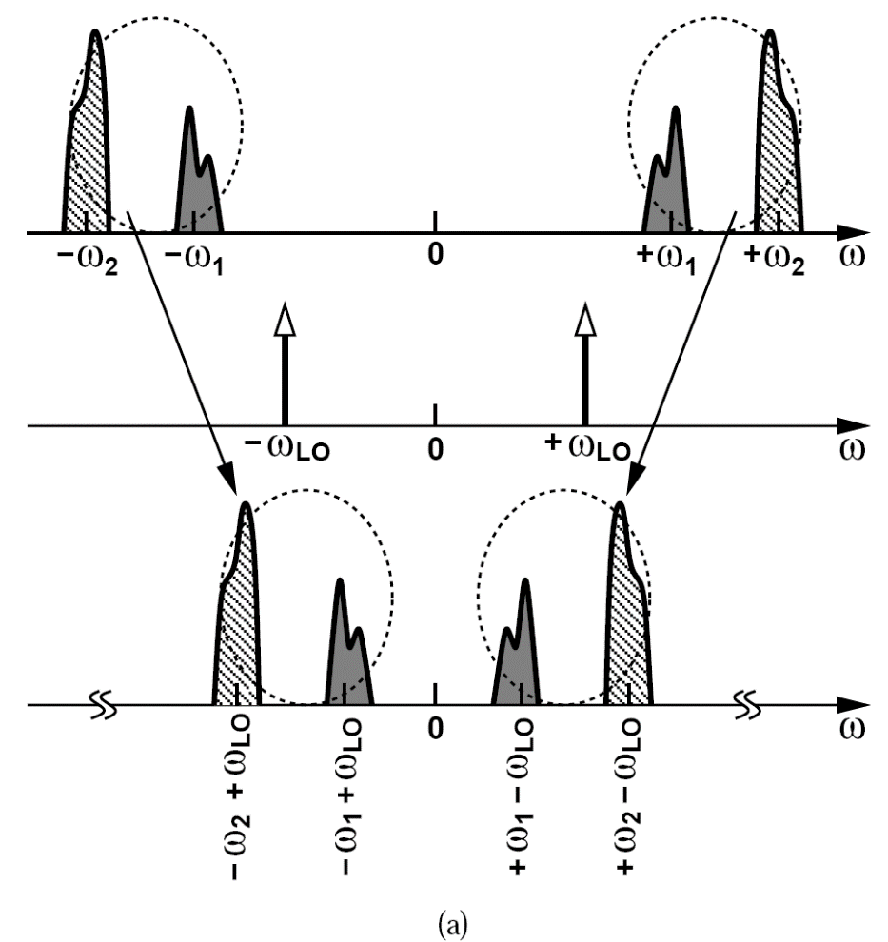
An Example of Image (Ⅰ)
Suppose two channels at ω₁ and ω₂ have been received and ω₁ < ω₂. Study the downconverted spectrum as the LO frequency varies from below ω₁ to above ω₂.
Solution:
ω_{LO} < ω₁ ω_{LO} slightly above ω₁
Notes:
Since ωLO<ω1, the positive input frequencies remain positive after downconversion, and the negative input frequencies remain
negative. Now consider the case depicted in Fig. 4.10(b), where ωLO is slightly greater than ω1. Here, after downconversion the channel at 1ω1 slides to negative frequencies while that at 1ω2 remains positive. If ωLO reaches (ω1 1 ω2)/2, then the received channels are
translated such that they completely overlap each other at the IF output [Fig. 4.10(c)]. That
is, ω1 and ω2 are images of each other. Finally, if ωLO is greater than ω2, both positive input
frequencies are shifted to negative values, and both negative input frequencies are shifted
to positive values [Fig. 4.10(d)].

Slide 12
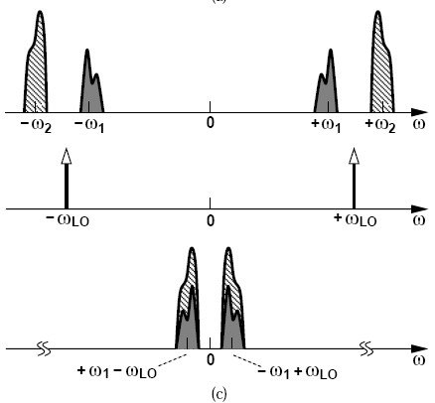
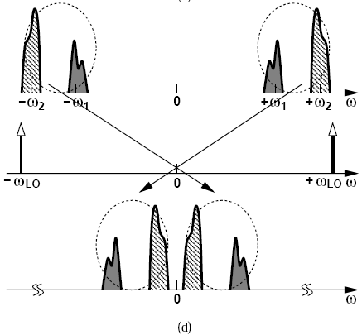
An Example of Image (Ⅱ)
Suppose two channels at ω₁ and ω₂ have been received and ω₁ < ω₂. Study the downconverted spectrum as the LO frequency varies from below ω₁ to above ω₂.
Solution:
ω_{LO} midway between ω₁ and ω₂ ω_{LO} > ω₂

Slide 13

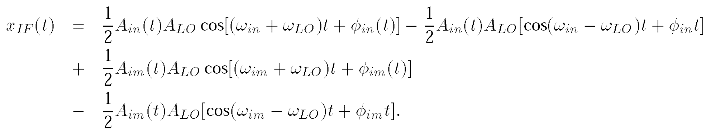
Another Example of Image
Formulate the downconversion above using expressions for the desired signal and the image.
Solution:
and
We observe that the components at ω_{in} +ω_{LO} and ω_{im} +ω_{LO} are removed by low-pass filtering, and those at ω_{in} - ω_{LO} = -ω_{IF} and ω_{im} - ω_{LO} = +ω_{IF} coincide.

Slide 14
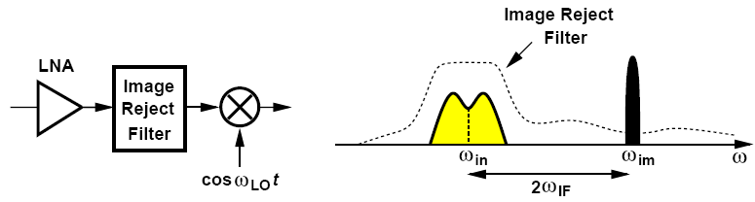
Image Rejection
The most common approach is to precede the mixer with an “image-reject filter”
A filter with high image rejection typically appears between the LNA and the mixer so that the gain of the LNA lowers the filter’s contribution to the receiver noise figure
The linearity and selectivity required of the image-reject filter have dictated passive, off-chip implementations.

Slide 15
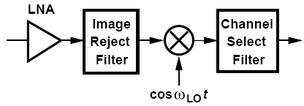
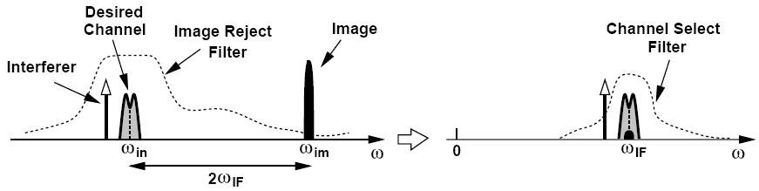
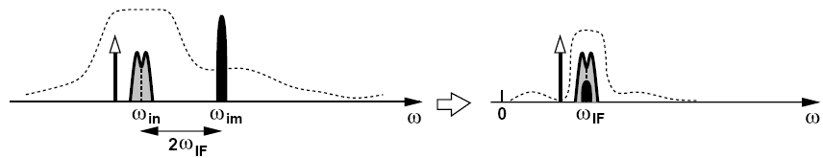
Image Rejection versus Channel Selection
A high IF allows substantial rejection of the image.
A low IF helps with the suppression of in-band interferers.

Slide 16
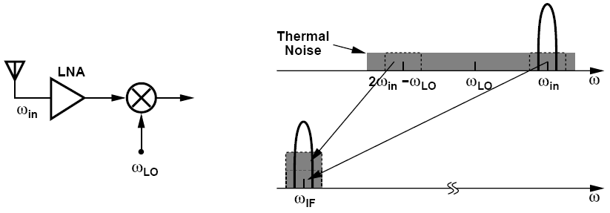
An Example of Noise Figure in Receiver
An engineer is to design a receiver for space applications with no concern for interferers. The engineer constructs the heterodyne front end shown in figure below (left), avoiding band-select and image-select filters. Explain why this design suffers from a relatively high noise figure.
Even in the absence of interferers, the thermal noise produced by the antenna and the LNA in the image band arrives at the input of the mixer. Thus, the desired signal, the thermal noise in the desired channel, and the thermal noise in the image band are downconverted to IF, leading to a higher noise figure for the receiver (unless the LNA has such a limited bandwidth that it suppresses the noise in the image band). An image-reject filter would remove the noise in the image band. We return to this effect in Chapter 6.

Slide 17
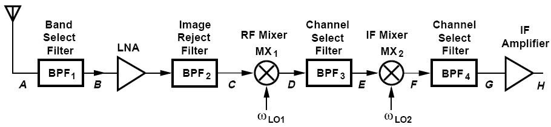
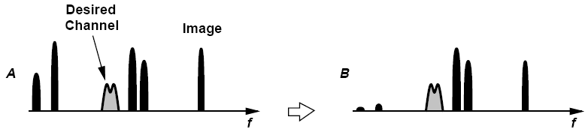
Dual Downconversion (Ⅰ)
The front-end filter selects the band while providing some image rejection as well (Point B)

Slide 18
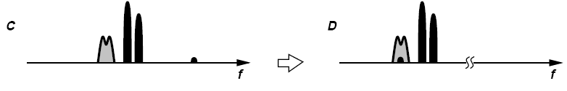

Dual Downconversion (Ⅱ)
After amplification and image-reject filtering, spectrum of C obtained
Sufficiently linear mixer translates desired channel and adjacent interferers to first IF (Point D)
Partial channel selection BPF₃ permits the use of a second mixer with reasonable linearity. (Point E)
Spectrum is translated to second IF. (Point F)

Slide 19
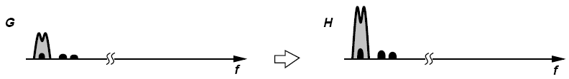
Receiver Architectures
BPF₄ suppresses the interferers to acceptably low levels (Point G)
An optimum design scales both the noise figure and the IP3 of each stage according to the total gain preceding that stage.

Slide 20
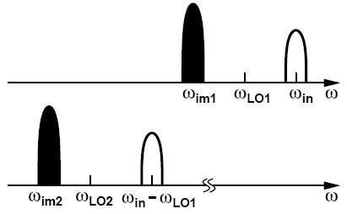
Another Example of Image
Assuming low-side injection for both downconversion mixers in figure above, determine the image frequencies.
Solution:
As shown below, the first image lies at 2ω_{LO1} -ω_{in}. The second image is located at 2ω_{LO2} - (ω_{in} - ω_{LO1}).

Slide 21
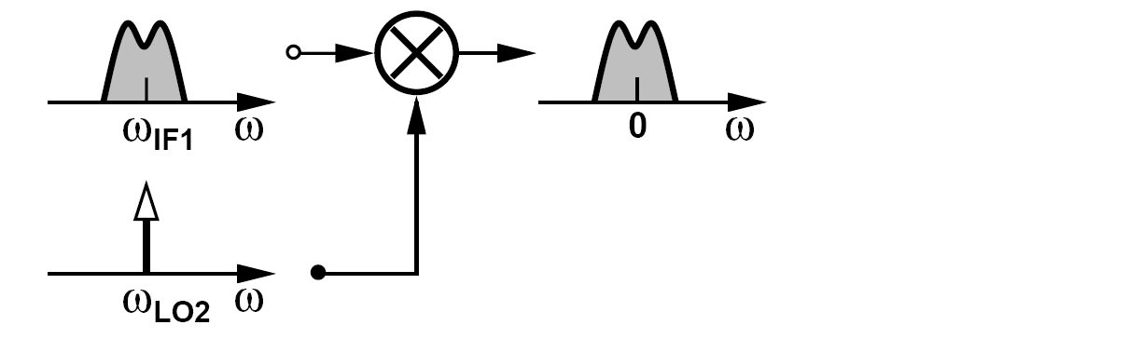
Zero Second IF
To avoid secondary image, most modern heterodyne receivers employ a zero second IF.
In this case, the image is the signal itself. No interferer at other frequencies can be downconverted as an image to a zero center frequency if ω_{LO2}=ω_{IF1}

Slide 22
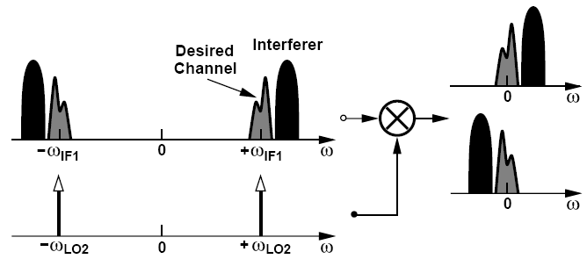
Example of Zero Second IF
Suppose the desired signal in figure above is accompanied by an interferer in the adjacent channel. Plot the spectrum at the second IF if ω_{LO2} = ω_{IF1}.
As shown below, the desired channel appears at ± ω_{IF1} and is accompanied by the interferer. Upon mixing in the time domain, the spectrum at negative frequencies is convolved with the LO impulse at +ω_{LO2}, sliding to a zero center frequency for the desired
channel. Similarly, the spectrum at positive frequencies is convolved with the impulse at -ω_{LO2} and shifted down to zero. The output thus consists of two copies of the desired channel surrounded by the interferer spectrum at both positive and negative frequencies.

Slide 23
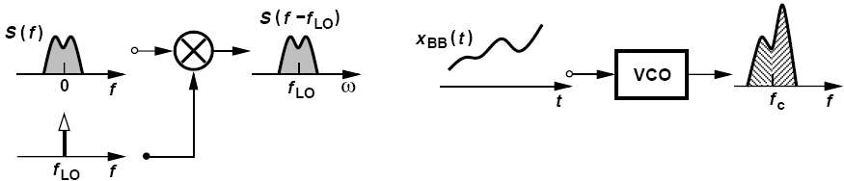
Symmetrically-modulated versus Asymmetrically-modulated Signal
AM signal generation FM signal generation
AM signals are symmetric, FM signals are asymmetric.
Most of today’s modulation schemes, e.g., FSK, QPSK, GMSK, and QAM, exhibit asymmetric spectra around carrier frequency.

Slide 24
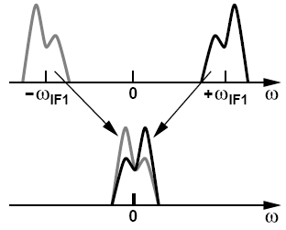
Corruption of the Asymmetric Signal Spectrum
Downconversion to a zero IF superimposes two copies of the signal
If the signal spectrum is asymmetric, the original signal spectrum will be corrupted

Slide 25
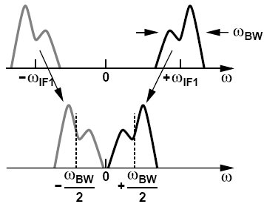
An Example of Self-corruption
Downconversion to what minimum intermediate frequency avoids self-corruption of asymmetric signals?
Solution:
To avoid self-corruption, the downconverted spectra must not overlap each other. Thus, as shown in figure below, the signal can be downconverted to an IF equal to half of the signal bandwidth. Of course, an interferer may now become the image.

Slide 26
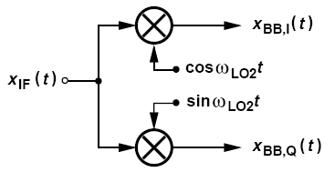
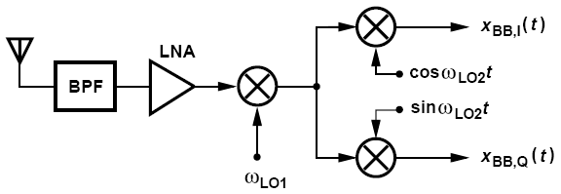
How can downconversion to a zero IF avoid self-corruption?
Quadrature downconversion
By creating two versions of the downconverted signal that have a phase difference of 90。
Notes:
Effect of 90 phase shift on a narrow band signal is to multiply the spectrum by G(w)=-j*sign(w)

Slide 27
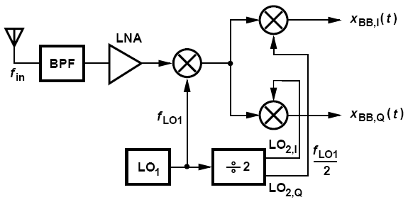
Sliding-IF Receivers
Modern heterodyne receivers employ only one oscillator
The second LO frequency is therefore derived from the first by “frequency division”
Notes:
they employ only one oscillator. This is because the design of oscillators and frequency synthesizers proves difficult and, more importantly, oscillators fabricated on the same chip suffer from unwanted coupling.

Slide 28
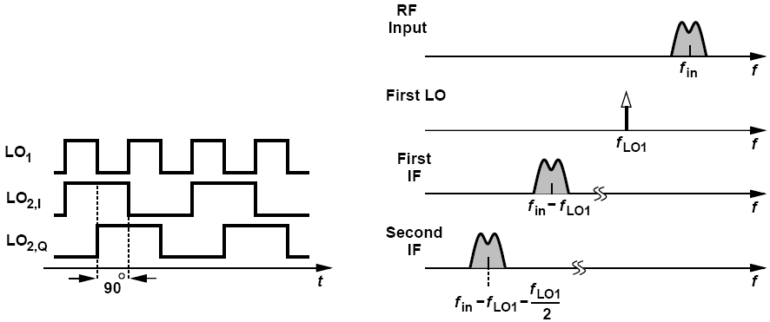
Sliding-IF Receivers: Divide-by-2 Circuit
Such divide-by-2 topology can produce quadrature output
The second LO waveforms at a frequency of f_{LO1}/2
Notes:
explained in Chapter 10, certain ÷2 topologies can produce quadrature outputs

Slide 29
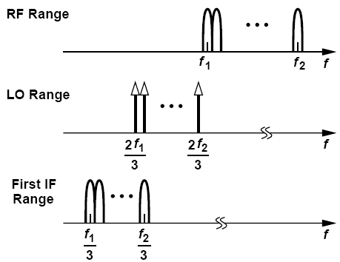
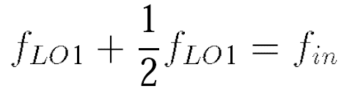
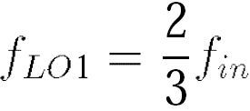
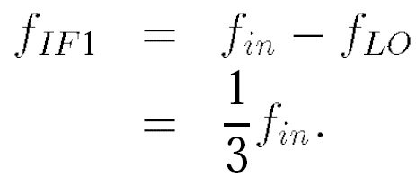
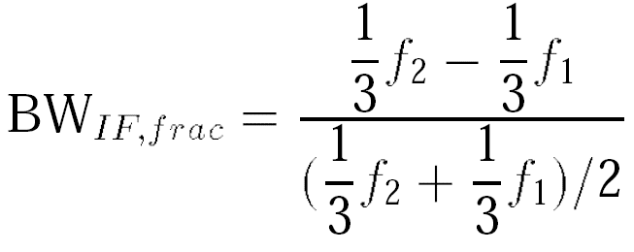
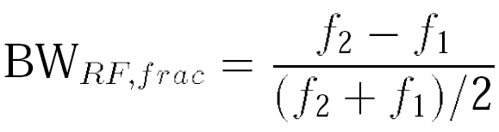
Interesting Properties of Sliding-IF Receivers
Fractional bandwidth:
IF
RF input
Notes:
Fractional bandwidth is defined as the bandwidth of interest divided by the center frequency of the band.
fin varies from f1 to f2, fIF1 goes from f1/3 to f2/3. For this reason, this topology is called the “sliding-IF architecture.

Slide 30
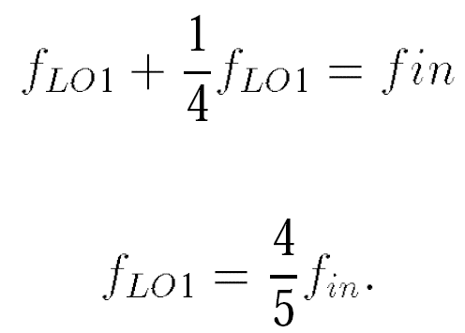
Sliding-IF Receivers with Divide Ratio of 4
May incorporate greater divide ratios, e.g., 4
Second LO f_{in}/5, slightly lower, desirable because generation of LO quadrature phases at lower frequencies incurs smaller mismatches
Reduces the frequency difference between the image and the signal, difficult to reject image.
Notes:
In other words, the choice of the divide ratio is governed by the trade-off between quadrature accuracy and image rejection.

